Slide 1
Java Plays – Mobile Starter Kit - Starter (Basic)
IBM

Slide 2


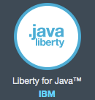

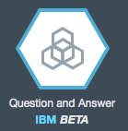
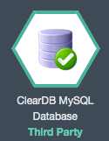
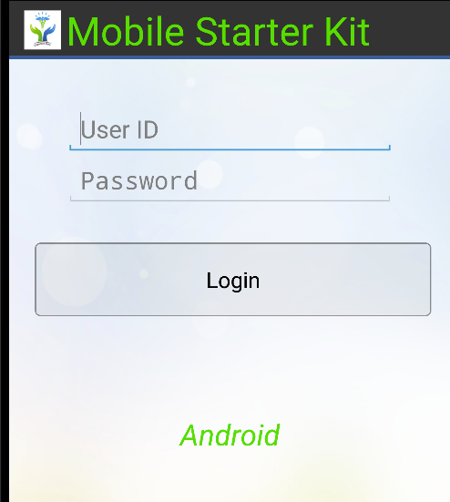
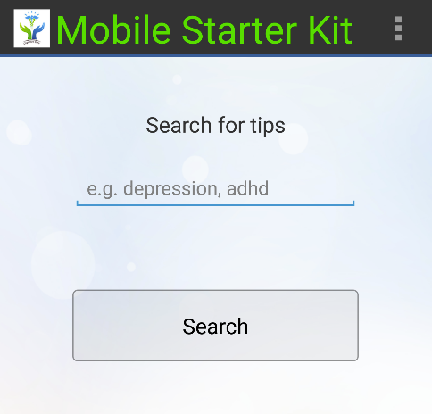
Mobile Starter Kit
Mobile Application (Android)
B
Starter
Basic Mobile Application (Android)
Basic Bluemix Java Application – REST Services
Bluemix Java Application
REST
USE CASE – A Cognitive health care solution that provides information about a disease or a symptom
Extend Bluemix Java Application
B
Extend Bluemix Java App
Extend the Basic RESTful Service to perform real time operations
Publish REST Service (Liberty & Java)
Bluemix Services
Extend Mobile Application (Android)
B
Extend Mobile Application
Extend the Mobile App to Integrate with the REST Services (Login, Searchtips)
Mobile Application
Bluemix Java App (Runtimes and Services)
REST
Notes:
2

Slide 3
Agenda
Pre-Requisites
Bluemix Java Application
Configure in Eclipse
Setup Bluemix
Import the Code from Git/Jazzhub
Create REST Services
Create Service
Code Walkthrough
Build & Deploy
Build the Application
Deploy to Bluemix
Test
Mobile UI (Application)
Configure
Setup AVD Manager
Setup SDK Manager
Import the Code
Create Application UI
Screen layouts/Form Inputs
Integrate with REST Service
Code Walkthrough
Build & Run
Build the Mobile Application
Run and Test the Application
Deploy and Test on Mobile
Notes:
3

Slide 4
Pre-Requisites
Create Bluemix Account
https://bluemix.net
https://hub.jazz.net
JDK 1.7
Eclipse Mars (Download – OS Specific)
https://eclipse.org/downloads/
Eclipse Marketplace
Install Bluemix Plugin
MySQL Workbench (Download - OS-Specific)
https://dev.mysql.com/downloads/workbench/
Notes:
4

Slide 5

Bluemix Java Application – Use Case
Login User
Use Case:
User logs in through a mobile app and asks a question
Ask a Question

Slide 6
Bluemix Java Application – Basic
Basic Application:
Create and Expose a Simple login REST Service, Searchtips Service in Bluemix
Create Simple UI Screens (Login, Search) and call REST Service in Bluemix

Slide 7
Bluemix Java Application - Configuration
There are two ways download the code and pre-requisites from for the bootcam
Option1: Get the Pre-Installed code and repository from the instructor
OR
Option 2: Go to Jazzhub and Get it
https://hub.jazz.net/git/ecosysdevcnc/javaplays-mobilestarterkit/
For Template
Javaplays-restjava-mobilestarterkit-template
For Extend – Fully Functional
Javaplays-restjava-mobilestarterkit-extend
For Basic Template Fully Functional
Javaplays-restjava-mobilestarterkit-basic
Notes:
7

Slide 8
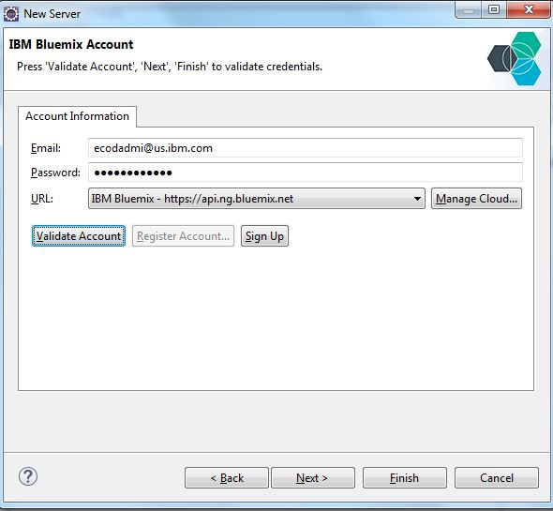
Bluemix Java Application – Configure Option2
Navigate to JEE perspective in eclipse (located on the left hand corner) →
Click on the link in the bottom panel to
Add a new Server → Select IBM Bluemix
Notes:
8

Slide 9
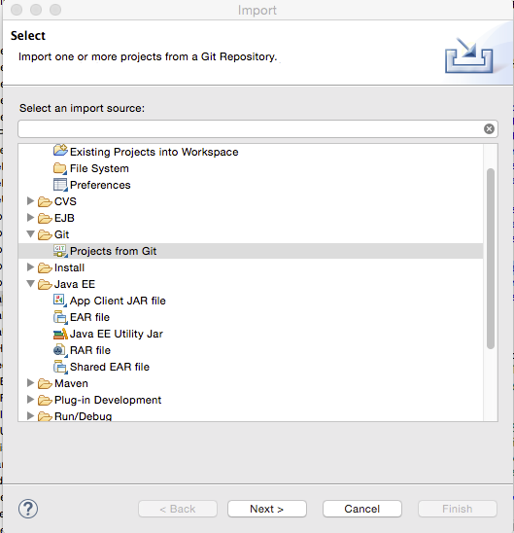
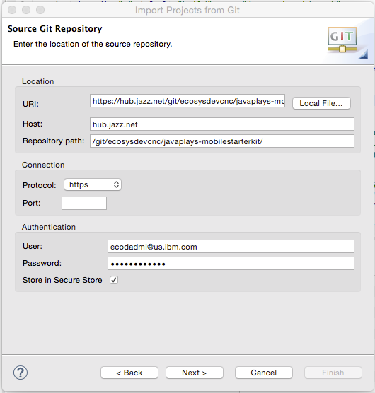
Bluemix Java Application – Configure Option 2- Pull the Code from JazzHub
Start Eclipse, open a workspace, and close the Eclipse Welcome page.
Select File → Import, Git → Projects from Git, Clone URI and clone the following URI
https://hub.jazz.net/git/ecosysdevcnc/javaplays-mobilestarterkit/
Notes:
9

Slide 10
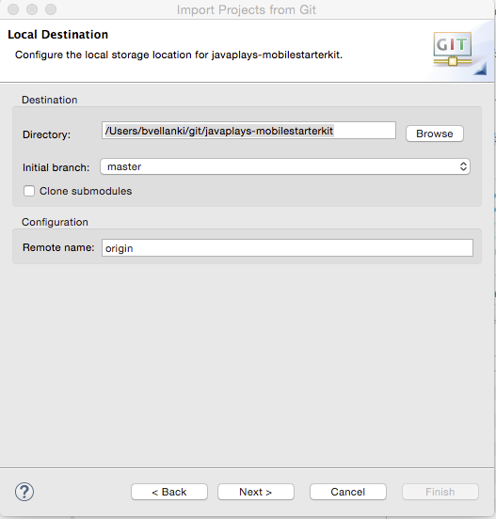
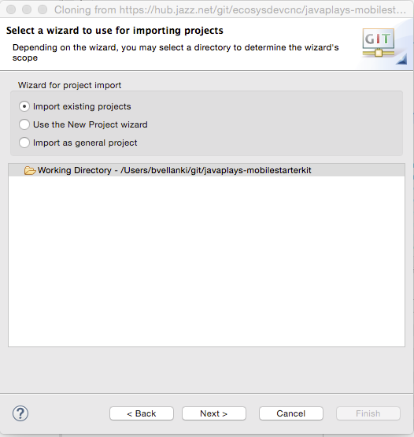
Bluemix Java Application – Configure Option 2 - Pull the Code from JazzHub (Cont’d)
Import the master branch to your local destination or location (directory)
Select “Import existing Projects” and select the directory for importing the existing project
Notes:
10

Slide 11
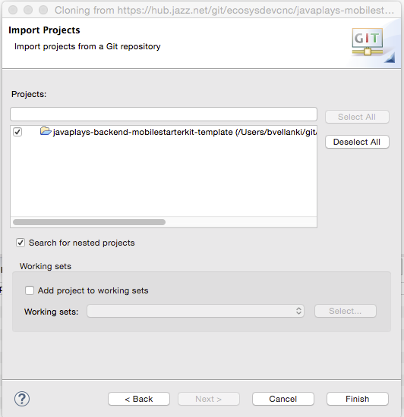
Bluemix Java Application – Configure Option2 - Pull the Code from JazzHub (Cont’d)
Select the server side code to import in to your eclipse workspace for development.
Notes:
11

Slide 12

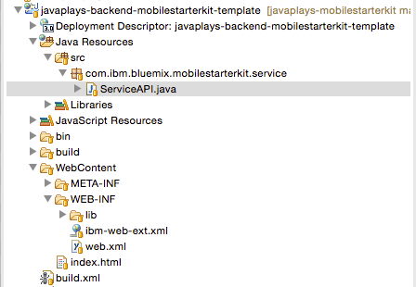
Bluemix Java Application – Create – ServiceAPI.java
Change the Eclipse Perspective (located on the right hand corner of the IDE) to Java EE. The server side code imported should be visible for deployment. Open ServiceAPI.java
Notes:
12

Slide 13
Bluemix Java Application – Create
Copy the attached code from template code (javaplays-restjava-mobilestarterkit-template/src) directory in to ServiceAPI.java
Open web.xml (located under javaplays-restjava-mobilestarterkit-template/WebContent/WEB_INF).
Copy the attached xml code or from template code directory in to web.xml
Notes:
13

Slide 14
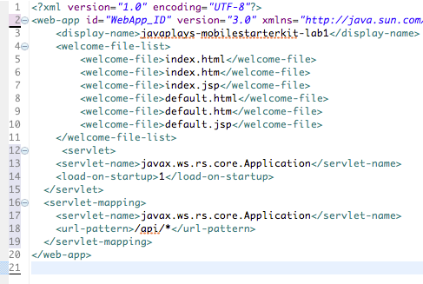
Bluemix Java Application – Create – web.xml Code Walkthrough
Web.xml
The web.xml file contains information about the structure and external dependencies of web components in the module and describes how the components are used at run time. To enable the web container to run Java API for RESTful Web Services (JAX-RS) applications, you can configure the web.xml file to point directly to the JAX-RS servlet. When using servlets, you can define a servlet path in the web.xml file that is appended to the base URL.
Then all the @Path and @Provider classes found in your web application will be available in the "default" JAX-RS application with a servlet URL pattern of "/api/*".
Notes:
14

Slide 15
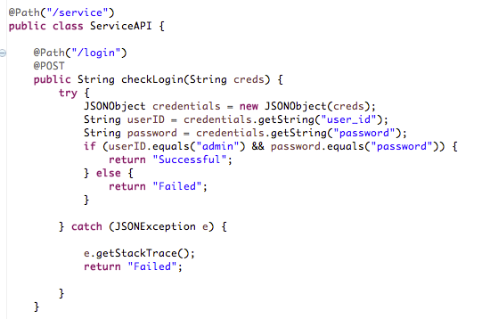
Bluemix Java Application – Create – ServiceAPI.java Code Walkthrough
/login POST RESTful Service
The all the @Path found in your Bluemix Java Application application will be available in the "default" JAX-RS application with a servlet URL pattern of "/api/*".
Based on the code for login as shown, the REST service can be invoked by calling the URL → http://<host:port>/api/service/login
The /login URI POST invocation will trigger checkLogin method. This method does the following actions:
Receives the data passed in as creds
Parses the user_id and password values Validates the credentials passed
Returns a Response
Notes:
15

Slide 16
Bluemix Java Application – Create – ServiceAPI.java (/login REST call)
/login POST RESTful Service
The all the @Path found in your Bluemix Java Application application will be available in the "default" JAX-RS application with a servlet URL pattern of "/api/*".
Based on the code for login as shown, the REST service can be invoked by calling the URL → http://<host:port>/api/service/login
The /login URI POST invocation will trigger checkLogin method. This method does the following actions:
Receives the data passed in as creds
Parses the user_id and password values Validates the credentials passed
{ “user_id”: “admin”,“password”:”password” }
Returns a Response string “Successful”
Notes:
16

Slide 17
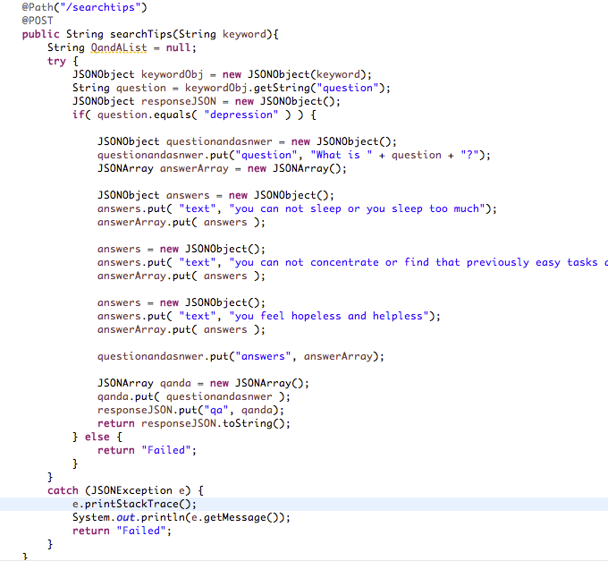
Bluemix Java Application – Create – ServiceAPI.java (/searchtips REST call)
/searchtips POST RESTful Service
The all the @Path found in your Bluemix Java Application application will be available in the "default" JAX-RS application with a servlet URL pattern of "/api/*".
Based on the code for login as shown, the REST service can be invoked by calling the URL → http://<host:port>/api/service/searchtips
The /searchtips URI POST invocation will trigger searchtips method. This method does the following actions:
Receives the data passed in as “keyword”
Parse the keyword and retrieve “question”-
Validates the question value passed
{ “question” : “depression” }
Construct and Return a Response string with all the Answers for a Question
Notes:
17

Slide 18
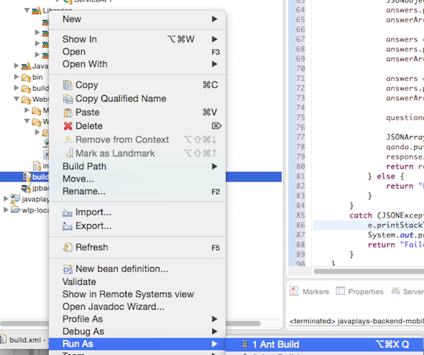
Bluemix Java Application – Build
Browse to root of the project (javaplays-restjava-mobilestarterkit-template/src)→Navigate to build.xml →Right Click →Ant Build
Notes:
18

Slide 19
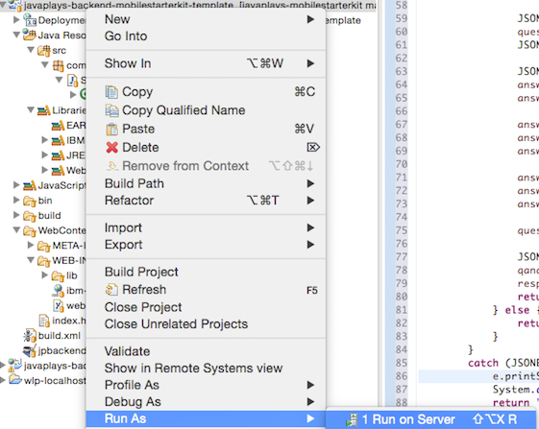
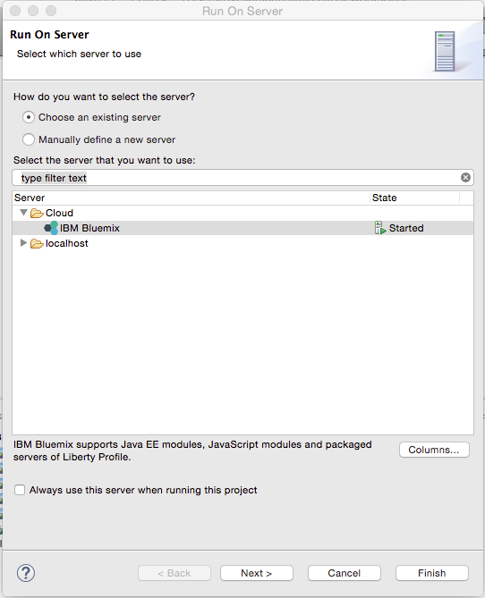
Bluemix Java Application – Deploy
Browse to root of the project ((javaplays-restjava-mobilestarterkit-template/src) →Right Click →Run on Server →Select Bluemix and Deploy
Notes:
19

Slide 20
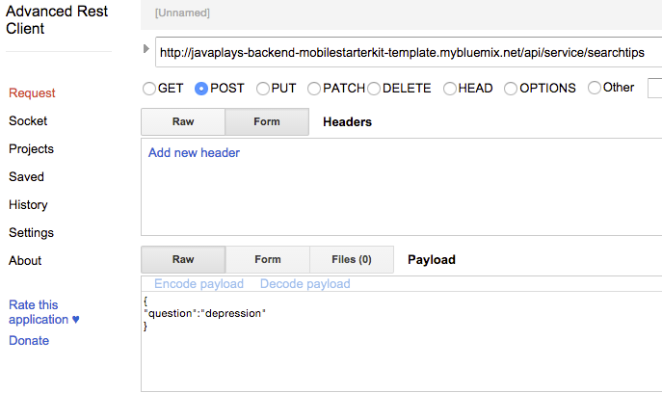
Bluemix Java Application – Test
Chrome Advanced REST Client – Test the REST service
RESULT →
{"qa":[{"answers":[{"text":"you can not sleep or you sleep too much"},{"text":"you can not concentrate or find that previously easy tasks are now difficult"},{"text":"you feel hopeless and helpless"}],"question":"What is depression?"}]}
Notes:
20

Slide 21
Mobile Application
Notes:
21

Slide 22
Setup Android Studio
Android Studio Setup
Android Studio is the official IDE for Android application development, based on IntelliJ IDEA. On top of the capabilities you expect from IntelliJ, Android Studio offers:
Download Android Studio from https://developer.android.com/sdk/installing/index.html?pkg=studio
Before you set up Android Studio, be sure you have installed JDK 6 or higher (the JRE alone is not sufficient)—JDK 7 is required when developing for Android 5.0 and higher. To check if you have JDK installed (and which version), open a terminal and type javac -version. If the JDK is not available or the version is lower than 6, go download JDK
Launch the .exe file you just downloaded.
Follow the setup wizard to install Android Studio and any necessary SDK tools.
On some Windows systems, the launcher script does not find where Java is installed. If you encounter this problem, you need to set an environment variable indicating the correct location.
Select Start menu > Computer > System Properties > Advanced System Properties. Then open Advanced tab > Environment Variables and add a new system variable JAVA_HOME that points to your JDK folder, for example C:\Program Files\Java\jdk1.7.0_21.
The individual tools and other SDK packages are saved outside the Android Studio application directory. If you need to access the tools directly, use a terminal to navigate to the location where they are installed. For example:
\Users\<user>\sdk\
Notes:
22

Slide 23
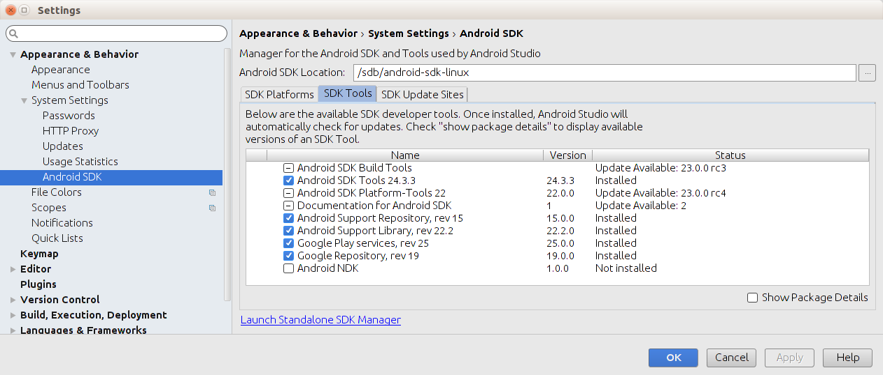
Setup SDK Manager
Android SDK Manager Setup
The Android SDK Manager separates the SDK tools, platforms, and other components into packages for easy access and management. You can also customize which sites the SDK Manager checks for new or updated SDK packages and add-on tools. For example, you can configure the SDK Manager to automatically check for updates and notify you when an installed SDK Tools package is updated. When you receive such a notification, you can then quickly decide whether to download the changes.
By default, Android Studio does not check for Android SDK updates. To enable automatic Android SDK checking:
Choose File > Settings > Appearance & Behavior > System Settings > Updates.
Check the Automatically check updates for Android SDK checkbox and select an update channel.
Click OK or Apply to enable the update checking.
You can launch the SDK Manager in one of the following ways:
From the Android Studio File menu: File > Settings > Appearance & Behavior > System Settings > Android SDK.
From the Android Studio Tools menu: Tools > Android > SDK Manager.
From the SDK Manager icon n in the menu bar.
By default, the SDK Manager installs the latest packages and tools.
Click the checkbox next to each additional SDK platform and tool that you want
to install. Clear the checkbox to uninstall a SDK platform or tool.
Click Apply or OK to update the packages and tools
Notes:
23

Slide 24
Setup AVD Manager
The AVD Manager is a tool you can use to create and manage Android virtual devices (AVDs), which define device configurations for the Android Emulator.
To launch the AVD Manager:
In Android Studio, select Tools > Android > AVD Manager, or click the AVD Manager in the Toolbar
Notes:
24

Slide 25
Mobile Application - Basics
Notes:
25

Slide 26
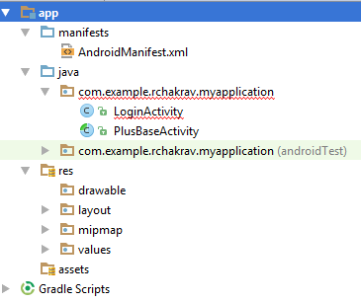
Native Android Application Development
Anatomy of a native Android Application Project
Manifests
Contains AndroidManifest.xml file
Java
Contains Java packages and class definition
Res
Defines various resources for the application
Assets
Declares any additional components required by the application
https://developer.android.com/tools/projects/index.html#ApplicationModules
Notes:
26

Slide 27
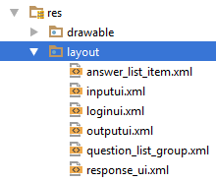
Native Android Application Development
Principal Concepts and Classes
Application
Binds everything together and maintains the global status of the application
http://developer.android.com/reference/android/app/Application.html
Activity
User interfaces
Each activity focuses on a specific part of the user interaction and several activities form an application
http://developer.android.com/reference/android/app/Activity.html
Designing interfaces
Each interface is designed in simple xml format under the project's res->layout section
Each interface consists of one or more “Views” (Buttons, TextViews, Editable Textboxes etc.)
arranged in specified layouts (Linear, Relative etc.)
http://developer.android.com/reference/android/view/View.html
http://developer.android.com/guide/topics/ui/declaring-layout.html
Notes:
27

Slide 28
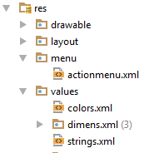
Native Android Application Development - Contd.
String constants
Instead of using constant values directly in the code, Android prefers defining each string constant as a resource in res->values->string.xml with unique ID
Once declared as resource, the string is available from anywhere through its unique ID
<resources>
<string name="login_text">Log In</string>
</resource>
<Button
android:text="@string/login_text" >
</Button>
Color constants can be defined in the same way in res->values->color.xml and accessed from anywhere using the ID
More about Resources : http://developer.android.com/guide/topics/resources/index.html
Notes:
28

Slide 29
Native Android Application Development - Contd.
Putting things together
AndroidMenifest.xml contains essential information required to build and run the application
Defines specific SDK to use, minimum target Android version, access permissions required (Internet, sensors, Phonebook etc.)
Defines the main application class
Registers each of the activities
Identifies the “launching” activity
http://developer.android.com/guide/topics/manifest/manifest-intro.html
<manifest xmlns:android="http://schemas.android.com/apk/res/android" package="com.ibm.startkit.android.app" android:versionCode="1" android:versionName="1.0" > <uses-sdk android:minSdkVersion="16" android:targetSdkVersion="18" /> <!-- Permissions --> <uses-permission android:name="android.permission.INTERNET" /> <uses-permission android:name="android.permission.WAKE_LOCK" /> <uses-permission android:name="android.permission.GET_ACCOUNTS" /> <uses-permission android:name="android.permission.USE_CREDENTIALS" /> <uses-permission android:name="android.permission.ACCESS_WIFI_STATE" /> <application android:name="com.ibm.startkit.android.app.BlueMobileApp" android:allowBackup="true" android:icon="@drawable/logo" android:label="@string/app_name" android:theme="@style/AppTheme"> <activity android:name="com.ibm.startkit.android.view.apptasks.InputUI" android:label="@string/app_name" android:configChanges="orientation|screenSize"> </activity> <activity android:name="com.ibm.startkit.android.view.apptasks.OutputUI" android:label="@string/app_name" android:configChanges="orientation|screenSize"> </activity> <activity android:name="com.ibm.startkit.android.view.LoginUI" android:label="@string/app_name" android:configChanges="orientation|screenSize"> <intent-filter> <action android:name="android.intent.action.MAIN" /> <category android:name="android.intent.category.LAUNCHER" /> </intent-filter> </activity> </application> </manifest>
Notes:
29

Slide 30
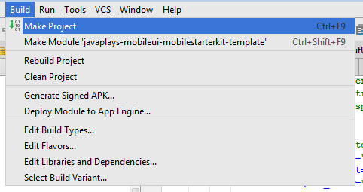
Native Android Application Development - Contd.
Building and running Android Application
Notes:
30

Slide 31
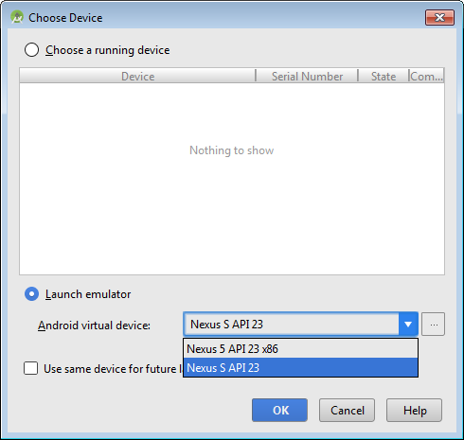
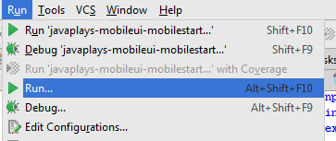
Native Android Application Development - Contd.
Running Android Application
Notes:
31

Slide 32
Mobile Application - Create
Notes:
32

Slide 33
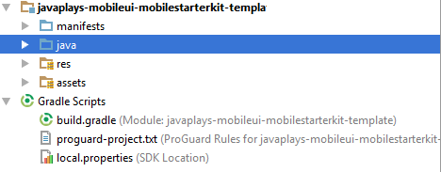
Let us develop something now...
Get the Code:
Option1 –
Get the Code and Android Studio Installable from the Instructor
Option 2 -
Download the template from Git
https://hub.jazz.net/git/ecosysdevcnc/javaplays-mobilestarterkit/
Javaplays-mobileui-mobilestarterkit-template
Unzip to folder
Javaplays-mobileui-mobilestarterkit-templatecode
Open the project in Android Studio
Select the Option → Open Existing Project → Select the Unzipped folder of the template → Javaplays-mobileui-mobilestarterkit-template
Also open Javaplays-mobileui-mobilestarterkit-templatecode folder files in another editor
Notes:
33

Slide 34
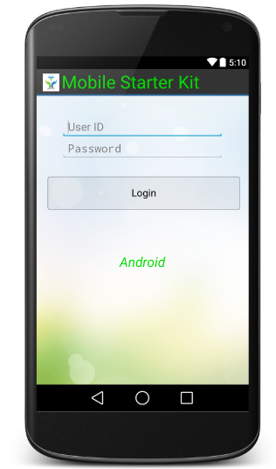
Make the Login Interface
Step 1 : Design the interface
Copy the code from loginui.xml.code to projects res->layout->loginui.xml
Step 2 : Set the content of the UI in LoginUI activity
In the project's java->com->ibm->startkit.android->view->LoginUI.java, locate the onCreate() event and uncomment the necessary code.
Step 3 : Add some event to the interface's button even
In the project's java->com->ibm->startkit.android->view->LoginUI.java, locate the setButtonEvent() function
Copy the code from loginui.button_event.code into the setButtonEvent() function
Step 4 : Execute an asynchronous task to check the user's validity
In the project's java->com->ibm->startkit.android->view->LoginUI.java, locate the checkLogin() function
Copy the code from loginui.checklogin.code into the checkLogin() function
At this stage, we have an UI that calls an Aynchronous task but the task itself is not ready
Notes:
34

Slide 35
Define the Asynchornous Task
Step 1 : Define the task
In the project's java->com->ibm->startkit.android->bluemix->LoginTask.java, locate the performTask() function
Copy the code from logintask.perform_task.code into performTask() function
Do NOT forget to remove the “return null” from the function
At this stage, we have an UI that calls an Aynchronous task and the task can execute a server side via REST API
Notes:
35

Slide 36
Receive the task when complete
Step 1 : Receive the task and take necessary steps
In the project's java->com->ibm->startkit.android->view->LoginUI.java, locate the receiveResult() function
Copy the code from loginui.receive_result.code into this function
At this stage, we have a working UI that can execute a REST API via asynchronous task and take necessary action once the task in complete
Notes:
36

Slide 37
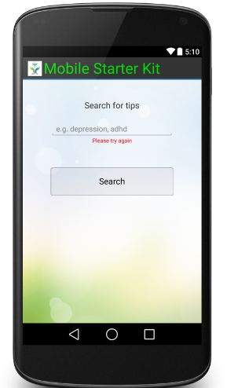
Make the Search Interface
Step 1 : Design the interface
Copy the code from searchui.xml.code to projects res->layout->searchui.xml
Step 2 : Set the content of the UI in LoginUI activity
In the project's java->com->ibm->startkit.android->view->apptasks->SearchUI.java, locate the onCreate() event and uncomment the necessary code.
Step 3 : Prepare the UI components and add some event to the interface's button even
In the project's java->com->ibm->startkit.android->view->apptasks->SearchUI.java, locate the setupUIComponents() function
Copy the code from searchui.setupUI.code into the setupUIComponents() function
Step 4 : Execute an asynchronous task to search for some tips
In the project's java->com->ibm->startkit.android->view->apptask->SearchUI.java, locate the doSearch() function
Copy the code from searchui.do_search.code into the doSearch() function
At this stage, we have an UI that calls an Aynchronous task but the task itself is not ready
Notes:
37

Slide 38
Define the Asynchronous task
Step 1 : Define the task
In the project's java->com->ibm->startkit.android->bluemix->SearchTipsTask.java, locate the performTask() function
Step 2 : Add some code to perform the remote API task
Copy the code from searchtipstask.perform_task.code into performTask() function
Do NOT forget to remove the “return null” from the function
At this stage, we have an interface that calls an Aynchronous task and the task can execute a server side via REST API
Notes:
38

Slide 39
Receive the task when complete
Step 1 : Receive the task and take necessary steps
In the project's java->com->ibm->startkit.android->view->apptasks->SearchUI.java, locate the receiveResult() function
Copy the code from searchui.receive_result.code into this function
At this stage, we have a working UI that can execute a REST API via asynchronous task and take necessary action once the task in complete
Notes:
39

Slide 40
Registering the interfaces
Step 1 : Manifests->AndroidManifest.xml
Copy the code from androidmanifest.activity_registration.code within the application tag
At this stage, we have a working application ready to be built and run
Confirm the “baseuri” value is correct in assets->starterkit.properties file
Notes:
40

Slide 41
Build the Android Application
Building and running Android Application
Notes:
41

Slide 42
Run the Android Application
Running Android Application
Notes:
42

Slide 43
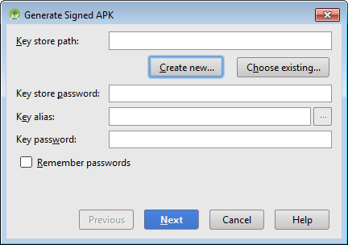
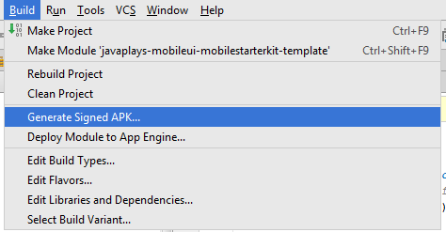
Generating an APK → Signing an Android Application
From Build menu choose “Generate Signed APK
From the dialogue box, click Create New
If you already have a keystore, please choose the Choose Existing and provide the necessary password
Notes:
43

Slide 44
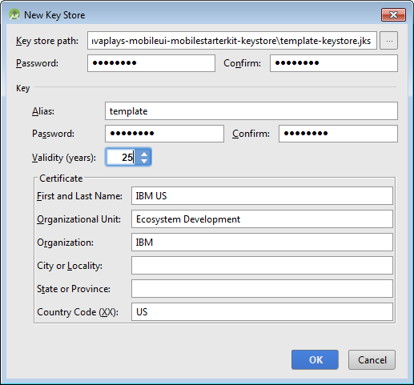
Generating an APK Signing an Android Application
Provide the Key Store Path
Provide the key
In this example every password is “template”
Notes:
44

Slide 45
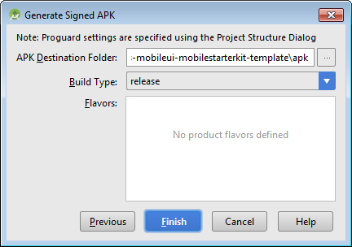
Signing an Android Application
Once successful, the wizard will ask for a destination
Click Finish
The process will confirm the generation of the APK
Now your application is ready to be released
Notes:
45

Slide 46

Task Execution Protocol – Step by step
S1 :
Activity creates the task and assigns an ID to it
Activity registers itself as a listener to the postExecution event of the task
Activity starts the task in a separate thread
S2 :
Task executes a POST method and waits for the result
S3 :
The response is received by the task thread
Task raises a postExecute() event and passes the response to any listener
S4 :
Activity responds to the event and process the result
S1
S2
Task
Extends : AsyncServiceTask
S4
S3
Activity
Implements : TaskReceiver
Notes:
46

Slide 47
Task Execution Protocol – Step by step
//SearchUI.java – if the user clicks the button
{
...
SearchTipsTask stt = new SearchTipsTask( ... );
stt.setReceiver(this);
stt.execute(_seeds);
...
}
S1
//AsyncServiceTask.java
@Override
protected String doInBackground( String... params ) {
//performTask is implemented by the
//SearchTipsTask class
return performTask( params );
}
S2
S3
@Override
public void receiveResult( String response,
String source ) {
{
//make sure the task ID is the search task
if( source.equals( correct_id ) ){
//perhaps do something with the response
}
}
S4
//AsyncServiceTask.java
@Override
protected void onPostExecute( String result ){
_response = result;
if( _tr != null ){
//calls the receiver's receiveResult function
//adds the serviceID here
//in this case the receiver is SearchUI.java
_tr.receiveResult( _response,_serviceID);
}
}
}
Notes:
47

Slide 48
How are all these stitched together? - without headache
com.ibm.android.asynctask.TaskReceiver - Interface
Every activity that required to use a REST API implements this class
This class enforces the activities to declare a receiveResult function
String response
The response received from REST call
String Source
The ID of the asynchronous task generating the response
public interface TaskReceiver{
public void receiveResult( String response, String source );
}
//Example : SearchUI.java
public void receiveResult( String response, String source ) {
//make sure the task ID is the search task
if( source.equals( SearchTipsTask._SEARCH_DOC_ID ) ){
//do something with the response
}
}
Notes:
48

Slide 49
How are all these stitched together? - without headache
com.ibm.android.asynctask.AsyncServiceTask - Abstract
Every task that calls REST API extends this class
This class enforces the tasks to define a REST API call
String... params
Input parameter needed for the task
public abstract String performTask( String... params)
throws IOException, JSONException, URISyntaxException;
//Example : SearchTipsTask
@Override
protected String performTask(String... params) throws IOException,
JSONException, URISyntaxException {
//retrieve the parameter
String keyword = params[0];
//POST and return the response
return performPost( ... );
}
Notes:
49

Slide 50
Questions?
Notes:
50

